Slide 1
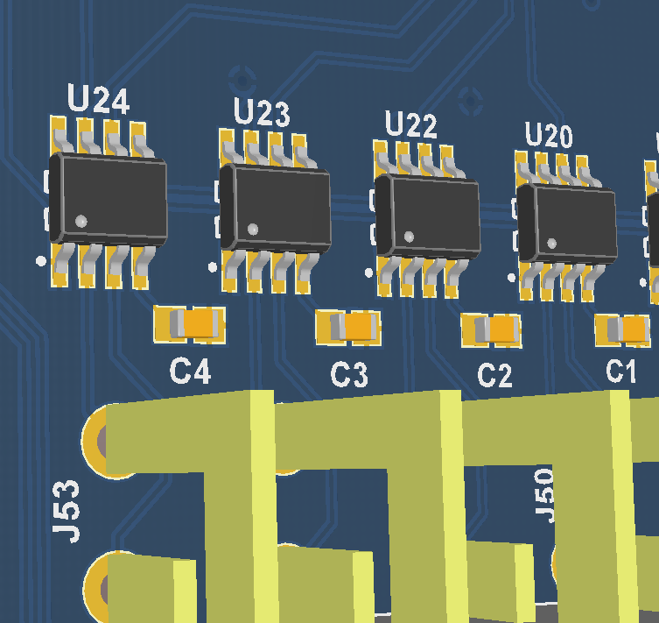
Place .01uF capacitor across pins 2 and 3 of ALL of the thermocouple measurement IC’s
If it is easier, an alternate solution is to solder the across the pins of the thermocouple connector on the bottom side of the PCB

Slide 2
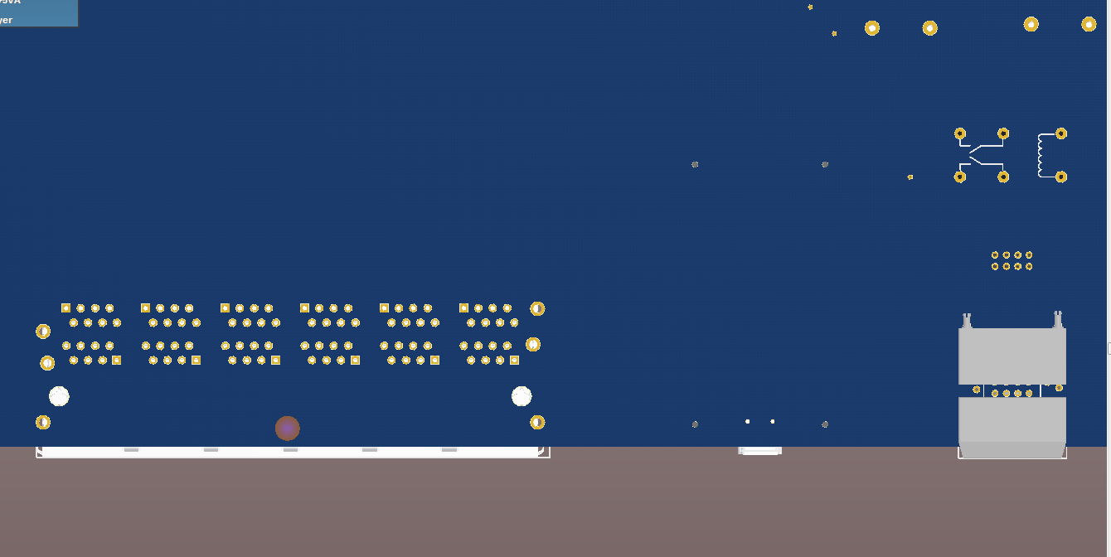
BOTTOM SIDE OF PCB
+15v Tap
Pins 10-2 & 10-4

